Slide 1




P25: AimBot using Object Detection
Walid HADRI
Notes:
I am Walid, I am working alone on the project of making an AI AimBot using Object Detection. The reason why I picked this project is that I wanted to work on something original, related to my passions and that I could continue working on as a long term project. I am going to be introducing the idea and motivation behind the project, then moving the solutions I am considering to develop, and finally the results I am getting and willing to have by the end.

Slide 2

The idea

Slide 3






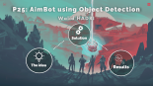
Notes:
I am going to assume that you have no prior knowledge about FPS Games, and if it is the case, don’t worry about it, I am going to give you a simple explanation.

Slide 4

FPS Ga mes

Slide 5

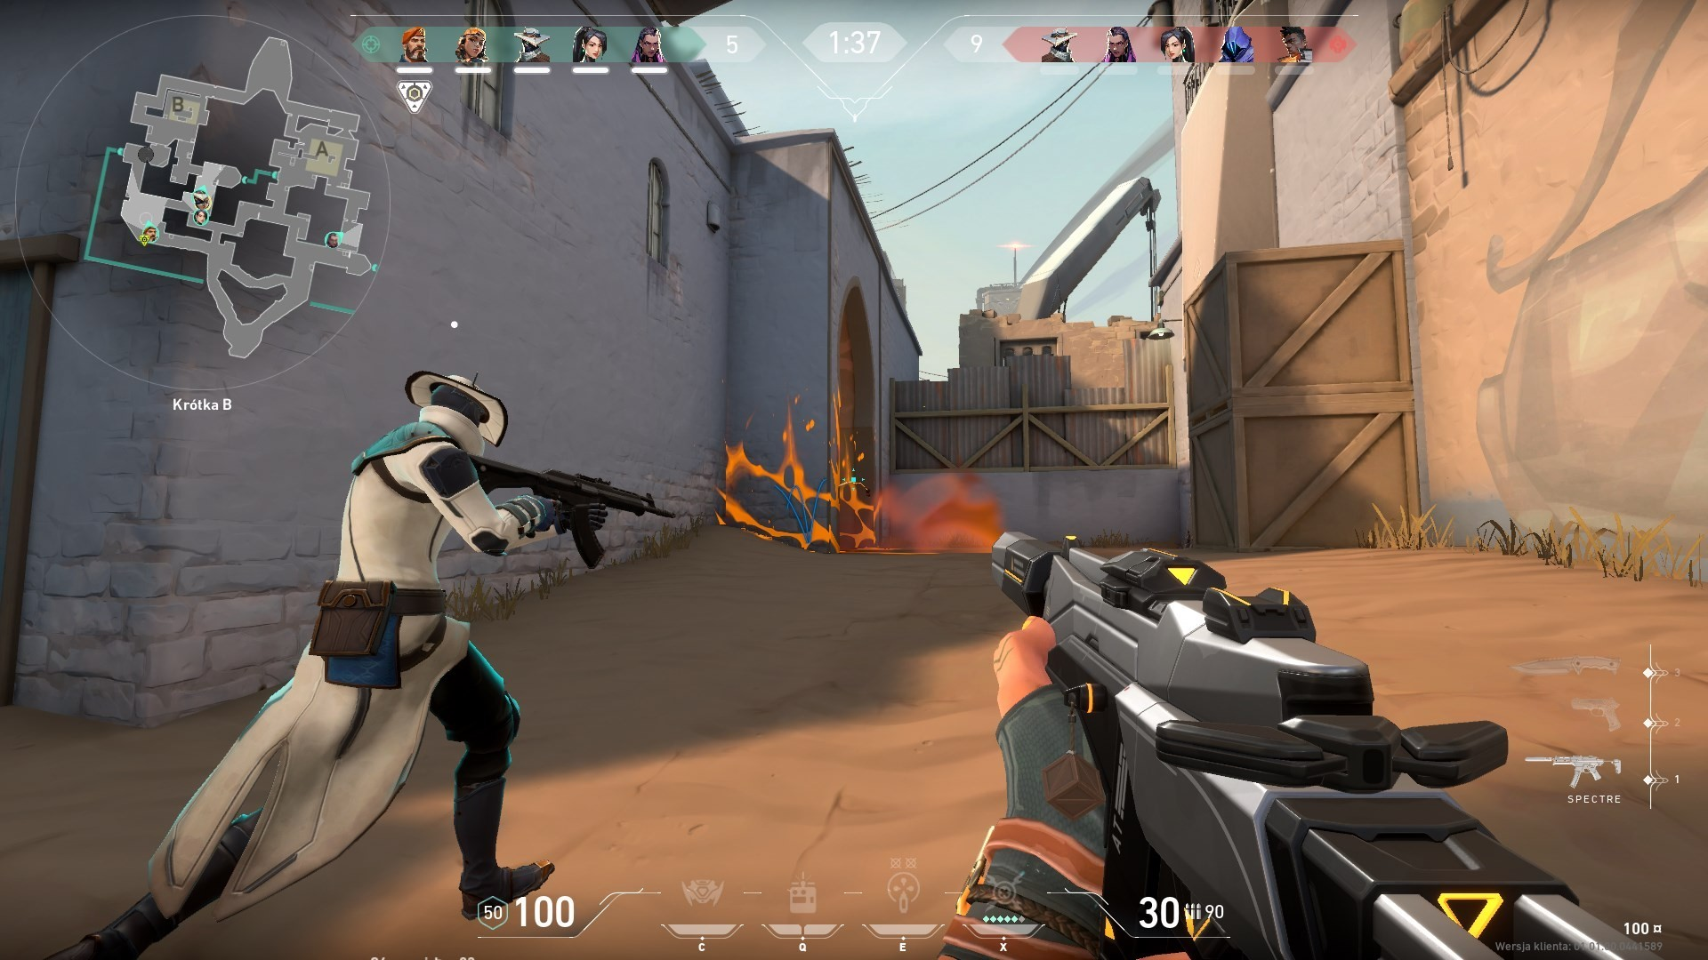
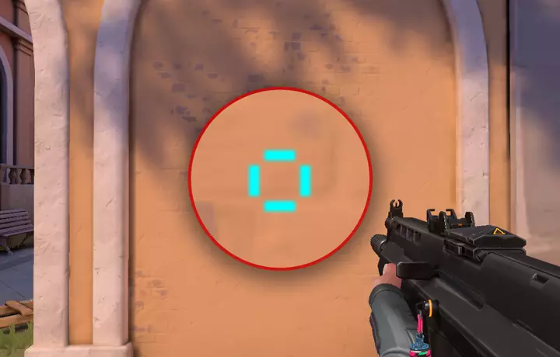


FPS: Stands for First Person Shooter, mostly played in computers using a keyboard for movement and a mouse for vision.
Notes:
FPS: stands for First Person Shooter, the screen is centered on your hand, possibly your gun or other weapon-based combat in a first-person perspective, with the player experiencing the action through the eyes of the controlled character. And when the game is about gun fights, beyond the movement with the keyboard, the main skill is actually being able to place the center of your screen where you would have what we call crosshair on the target. As you can see in the picture on the right, the blue lines define a precise area around the center of the screen, and you goal is to keep track of it and move it on your target, so you can hit some. In this project, I have been working on Valorant made by Riot Games.

Slide 6

Hacking

Slide 7
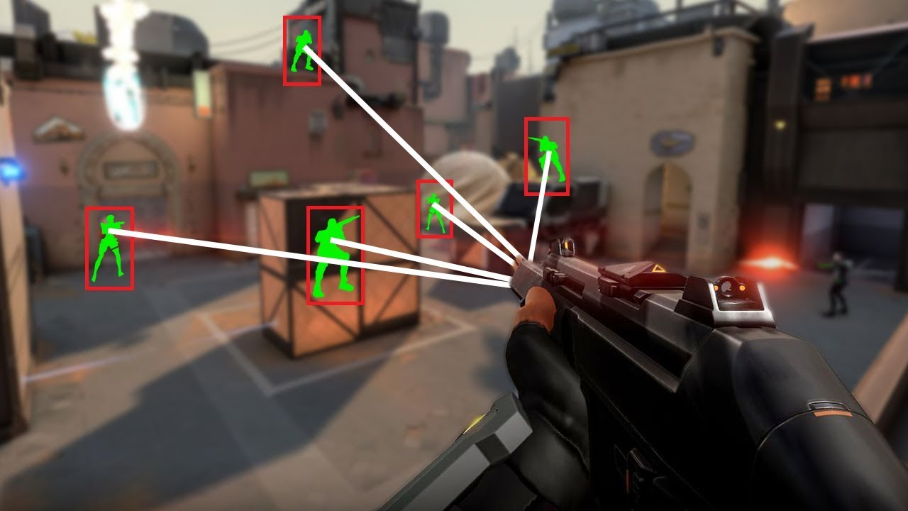




Hacking: interacting with the game files, messing up with packets
AI sees exactly what a human user would see (the screen)
Notes:
And as any other games, there are always people who tries to hack the gameplay, but making it easier for them and harder for their oppnents. The classical way of doing, is you either have access to the game files, especially if you are playing locally, or you are messing up with packets coming up from the server when you are playing online games, what I mean by messing up, is getting addtional information about the gameplay for example the location of the ennemies, their stamina, the items…. In this project, I am making the AI sees exactly what Human user would see on the screen without any additional information. And I am using Object detection techniques to be able to detect the targets and other items.

Slide 8

AI Aimbot

Slide 9
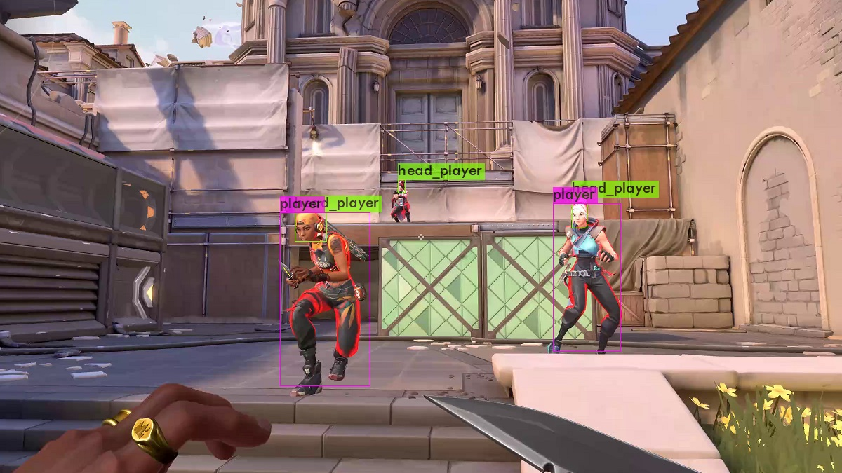

Detect players in the game, starting from an image to a video, to a real time inference and make the inference as faster as possible.
Detect part of the bodies ( the damage dealt depends on the part of the body you are aiming at)
Detect other items in the game
Command the mouse with the results
Make the bot more performing by reducing the inference area as the user helps with.
Notes:
As I said, the project is about making this Ai Aimbot, I have set up some milestones and objectives to reach through the project, that they evolve as I am working with new ideas coming up. First task, is being able to detect players on images, then on videos, and then being able to make the detection in real time. Second, as you don’t the same damage if you aiming at the legs or at the head, so detecting part of the body is an interesting milestone that I set up. The third idea, is being able to detect other items on the game for example weapons picked up by the players or on the floor. Beyond making the detection, I am willing to connect the mouse with the gameplay to send commands based on the output of the inference. Last, to make this bot actually effective in real gameplay, the inference time should be short.

Slide 10

Solution

Slide 11


Without Deep Learning
With Deep Learning
Notes:
There are two approaches that we could consider to have an AI Aimbot. With and without deep learning

Slide 12

Without Deep Learning
With Deep Learning
Image Processing
Filtering
Feature Detection (Edge detection)
Template Matching
(VIC Course)
Notes:
For without deep learning, no neural networks, this actually a part not included in the project of this course, but it is a part that I am working on the VIC course as my project. And it involves Image Processing, Filtering, Feature Detection and Template Matching, I am using Python combined with OpenCV on this part.

Slide 13

Without Deep Learning
With Deep Learning
Use Yolo Architecture with different configuration (Peformance vs Inference Time)
Use DFF Neural Networks to make a classification task (player present in the image or not)
Notes:
For with deep learning, I am trying different ideas, the main one is using Yolo Architecture with different configuration to train it and then make the inference. I am also working on building using Pytorch a Deep Feed Forward Neural Network to make the classification task of having a player on the screen or not.

Slide 14

Results

Slide 15
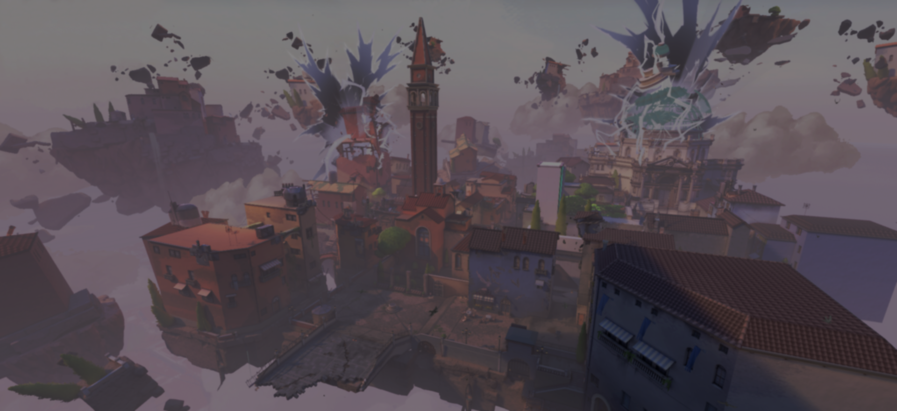
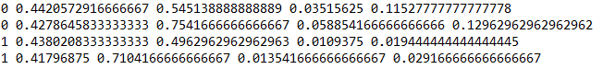
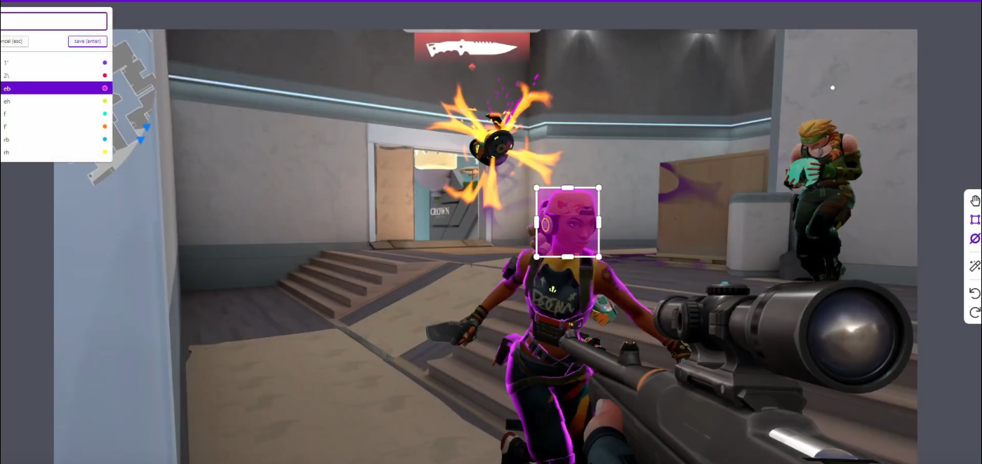


YoloLab
Image Labeling
2K labeled images
Notes:
I have been able to label manually around 2k images using YoloLab, in order to generate the files to train yolo, the files would like the image with the number on the top right, where you have the class of the object and the bouding box around it. I had the idea of using the pre-trained yolo to make this process semi-automatic as the players are detected as people, and correct the inference when it is not right, I still didn’t get time to make this part. But with 2k labled images, the results are already good.

Slide 16

Try different yolo arichectures
Generate the weights
Training
Notes:
One the images are labelled, we have our training dataset, we make a configuration for the training and we generate the weights file.

Slide 17
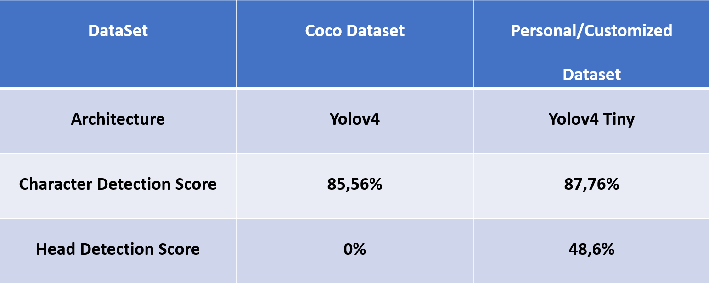
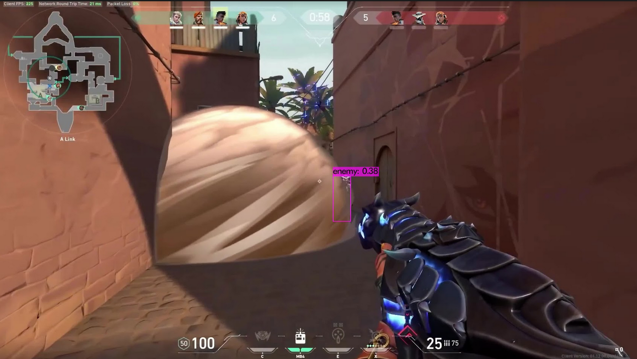
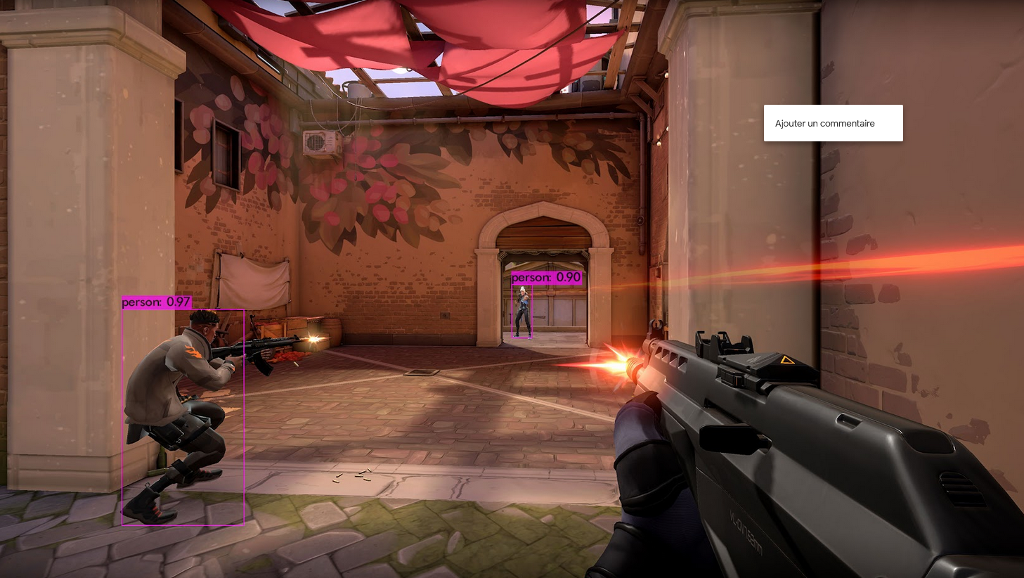
Evaluate the detection
Results
Notes:
For the evaluation, I have to evaluate the inference time, find an equilbrium between the complexity of the architecture and the time for inference. As you can see on right the detection is relevant even in bad environment, and the results are still to be improved.

